Slide 1
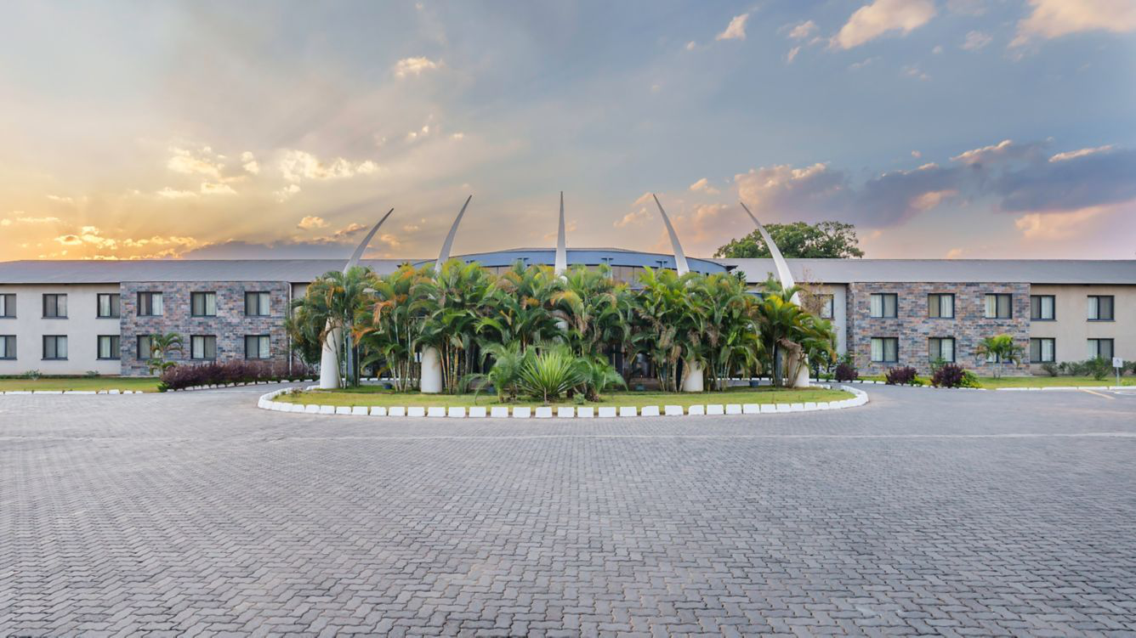
PROTEA HOTEL WEBSITE

Slide 2
Team Members
Kondwani Mubanga-2307066
Lubuto Mutamba-2306981
Naomi Akilimai-2206867
Mapalo Chilufya-2206716
Mainza Linyando-2307185

Slide 3
Introduction
We were given the task of designing a dynamic website for Protea Hotel Ndola.
The assumption we were to make was that we were at the testing phase of said website.
We were also tasked with selecting one functional and one non-functional requirement for the website. From these two detailed test cases for each requirement were to be made.

Slide 4
Functional Requirement: Booking a Room Online
The website must allow users to search for available rooms, select a date, and complete a room reservation online.

Slide 5
Functional Requirement: Booking a Room Online
Test Case 1: Booking Process Completeness
Requirement: Ensure that the user can complete the booking process from room selection to confirmation.
Preconditions: Rooms are available for the selected dates.
Test steps:
1. Go to the "Book a Room" page.

Slide 6
Functional Requirement: Booking a Room Online
2. Enter check-in and check-out dates.
3. Select room type and number of rooms.
4. Enter guest information and payment details.
5. Submit the booking form.

Slide 7
Functional Requirement: Booking a Room Online
Test Case 2: Search Availability for Specific Dates
Requirement: Verify that the website accurately shows room availability for selected dates.
Preconditions: Rooms are available and the database is updated.
Test Steps:

Slide 8
Functional Requirement: Booking a Room Online
1. Go to the "Book a Room" page.
2. Select a check-in and check-out date.
3. Click "Search" to check for available rooms.
Expected Result:
Available rooms for the selected dates are displayed with correct room types and prices (Krause, 2016).

Slide 9
Non-functional Requirement: Website Load Time
Test Case 1: Page Load Speed (Computer)
Preconditions: Stable internet connection is available.
Test Steps:
1. Open a browser (e.g., Chrome) on a desktop device.
2. Enter the website URL.
3. Measure the time taken for the homepage to fully load.

Slide 10
Non-functional Requirement: Website Load Time
Expected Result:
The homepage should fully load in less than 3 seconds.
Actual Result: (To be filled during testing)
Pass/Fail Criteria: Pass if the homepage loads within the time frame.

Slide 11
Non-functional Requirement: Website Load Time
Test Case 2: Page Load Speed (Mobile)
Test Steps:
1. Open a browser (e.g., Safari, Chrome) on a mobile device.
2. Enter the website URL.
3. Measure the time taken for the homepage to fully load.

Slide 12
Non-functional Requirement: Website Load Time
Expected Result:
The homepage should fully load in less than 3 seconds.
Actual Result: (To be filled during testing)
Pass/Fail Criteria: Pass if the homepage loads within the time frame on a mobile device.

Slide 13
Non-functional Requirement: Website Load Time
These test cases cover both the core functionality of room booking and the non-functional performance aspect related to speed, ensuring the website delivers essential services efficiently(Krause, 2016).

Slide 14
References
Jörg Krause. (2016). Introducing Web Development. Berkeley, Ca Apress.

